Slide 1
PowerPoint template for the 2021 Black History Month Assembly for:
Secondary aged students
We know that good teaching is tailored to meet the needs of the children or young people in each individual class. That’s why we’ve created this editable PowerPoint template – feel free to adapt it to suit your teaching context or to add your school or college slide template to the background.
Who are Stonewall?
This resource is produced by Stonewall, a UK-based charity that stands for the freedom, equity and potential of all lesbian, gay, bi, trans, queer, questioning and ace (LGBTQ+) people. At Stonewall, we imagine a world where LGBTQ+ people everywhere can live our lives to the full. Founded in London in 1989, we now work in each nation of the UK and have established partnerships across the globe. Over the last three decades, we have created transformative change in the lives of LGBTQ+ people in the UK, helping win equal rights around marriage, having children and inclusive education.
Our campaigns drive positive change for our communities, and our sustained change and empowerment programmes ensure that LGBTQ+ people can thrive throughout our lives. We make sure that the world hears and learns from our communities, and our work is grounded in evidence and expertise.
Stonewall is proud to provide information, support and guidance on LGBTQ+ inclusion; working towards a world where we’re all free to be. This does not constitute legal advice, and is not intended to be a substitute for legal counsel on any subject matter. To find out more about our work, visit us at www.stonewall.org.uk.
Registered Charity No 1101255 (England and Wales) and SC039681 (Scotland)
Notes:
Visit our website for the lesson plan to accompany this PowerPoint.

Slide 2
Opening title slide
Black History Month
Notes:
This assembly is for secondary aged students. Check our website www.stonewall.org.uk for a similar assembly for primary aged children. You’ll also find versions of this assembly for children and young people with SEND/ALN/ASN.

Slide 3
Divider slide 2
What is Black History Month?
?
?
?
?
Notes:
Ask students if they have heard of Black History Month before. Why might it be needed?
Discuss that the history of Black people in Britain and across the world is often overlooked and historically hasn’t been talked about in schools. This is because of racist attitudes that suggest Black people’s lives and stories are not important. Black History Month aims to change that. It is important to know all of our history and Black history month is a great time to be celebrating some amazing Black people from our history. And that’s just what we’re going to be doing in this assembly.

Slide 4
Quote and image slide 1
Ted Brown
One of the early members of the Gay Liberation Front.
In 1972 was involved in organizing the first LGBTQ+ pride march in London.
There was a march through London and then a ‘kiss in’ at Trafalgar Square.
Notes:
Introduce Ted Brown – he was one of the early members of an organisation called the Gay Liberation Front, which is an organisation that campaigned for fair and equal treatment for LGBTQ+ people in the UK. The UK’s first Pride March was in 1972 and involved a ‘kiss in’ at Trafalgar Square – Ted helped to organise this and many other marches and protests. Ted was one of only a few Black people at the march – not because there weren’t many Black LGBTQ+ people, but because Black LGBTQ+ people experienced (and still experience) racism as well as homophobia, biphobia and transphobia, making it even scarier to attend a public protest.

Slide 5
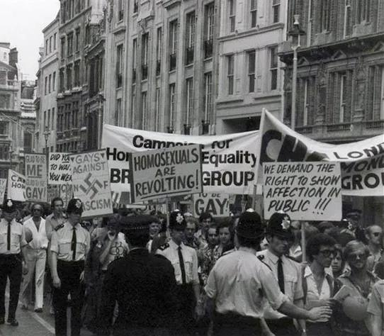
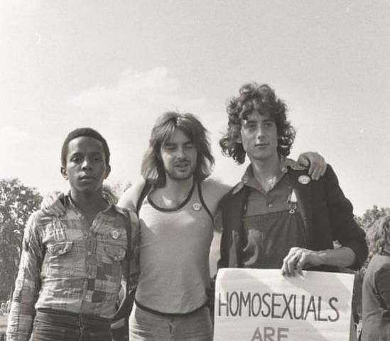
Infographic slide - style 1
Why was LGBTQ+ pride needed in 1972?
London’s 1972 pride march was arranged to take place on the weekend closest to the anniversary of the Stonewall uprising. The Stonewall uprising was a riot against homophobia, biphobia and transphobia led by Black and brown LGBTQ+ people.
Notes:
Explain that London’s 1972 pride march was arranged to take place on the weekend closest to the anniversary of the Stonewall uprising. The Stonewall uprising was a riot against homophobia, biphobia and transphobia led by Black and brown LGBTQ+ people.
Ensure that you have covered that in 1972:
Being LGBTQ+ was still classed as an illness
There were no laws against homophobic, biphobic and transphobic discrimination
Homophobia, biphobia and transphobia was common (and sadly still is)
LGBTQ+ people couldn’t get married or adopt
Lesbian mothers had their children taken away from them by the courts
Gay men frequently experience police harassment – this is something that also happened to Black people too.
(For teacher background knowledge see: https://www.crimeandjustice.org.uk/sites/crimeandjustice.org.uk/files/09627250608553116.pdf and https://galop.org.uk/about/history/)

Slide 6
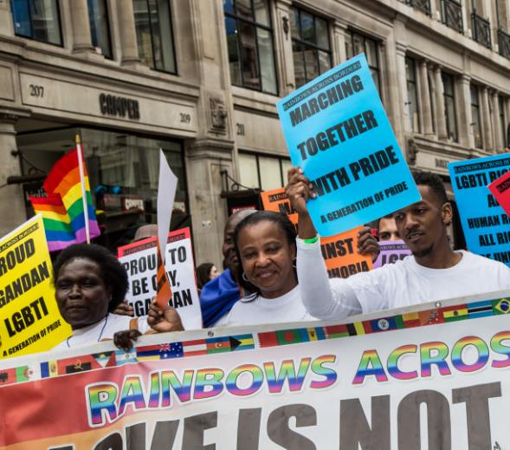
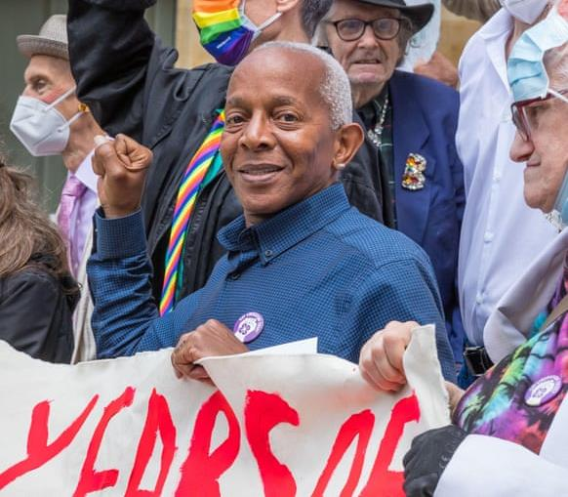
Infographic slide - style 1
Why is LGBTQ+ pride still needed?
UK Black Pride was set up in 2005 by a group of Black women and is growing year on year.
Why might Black Pride in particular be needed?
Notes:
Ask students why LGBTQ+ pride might still be needed.
Ensure that you have discussed:
LGBTQ+ people are still subject to discrimination and harassment at work, in education and in the community
It is not currently illegal to practice conversion therapy, where ‘therapists’ treat LGBTQ+ people as if being LGBTQ+ is an illness to be ‘cured’
Not all trans people are able to change their birth certificate
There are still countries where it is illegal to be LGBTQ+ and where LGBTQ+ people are not protected from discrimination and can’t get married or have children.
Explain that UK Black Pride is an LGBTQ+ pride event run by LGBTQ+ People of Colour, for LGBTQ+ People of Colour
Ask students why UK Black pride might be needed.
Ensure that you have discussed:
LGBTQ+ People of Colour experience both racism (unfair treatment because of the colour of their skin) and homophobia, biphobia and transphobia (unfair treatment because of who they fall in love with or because their gender is different to the one they were labelled with at birth)
LGBTQ+ People of Colour experience racism within the wider LGBTQ+ community
The voices of LGBTQ+ People of Colour are too often not listened to in the wider LGBTQ+ community

Slide 7
Quote and image slide 2
Who are the Gay Liberation Front?
Ted was part of the UK’s Gay Liberation Front.
Their first protest was in 1970 and was run by people who met at the Mangrove, a Caribbean restaurant in London.
The Gay Liberation Front were inspired by a group called The Black Panthers.
Notes:
Quickly explain who the Gay Liberation Front were.
The UK’s Gay Liberation Front held their first meeting in 1970
Their first protest was in 1970 and was run by people who met at the Mangrove, a Caribbean restaurant in London.
The Gay Liberation Front were inspired by and had links to a group called The Black Panthers – the Black Panthers also had meetings at the Mangrove.

Slide 8
Quote and image slide 1
Ted Brown
One of the early members of the Gay Liberation Front.
In 1972 was involved in organizing the first LGBTQ+ pride march in London.
There was a march through London and then a ‘kiss in’ at Trafalgar Square.
Notes:
Introduce Ted Brown – he was one of the early members of an organisation called the Gay Liberation Front, which is an organisation that campaigned for fair and equal treatment for LGBTQ+ people in the UK. The UK’s first Pride March was in 1972 and involved a ‘kiss in’ at Trafalgar Square – Ted helped to organise this and many other marches and protests. Ted was one of only a few Black people at the march – not because there weren’t many Black LGBTQ+ people, but because Black LGBTQ+ people experienced (and still experience) racism as well as homophobia, biphobia and transphobia, making it even scarier to attend a public protest.

Slide 9
Quote and image slide 2
Who were the Black Panthers?
A Black led and run political organization set up in 1966 in the United States, with chapters worldwide.
Campaigned and protested against racism and police harassment.
Set up community initiatives such as providing free breakfast for children, education programmes, and health clinics.
Notes:
Explain who the Black Panthers were.
A Black led and run political organization set up in 1966 in the United States, with chapters worldwide.
Campaigned and protested against racism and police harassment. For example, in London there were protests against police harassment organized by the British Black Panthers.
They set up community initiatives such as providing free breakfast for children, education programmes, and health clinics.

Slide 10
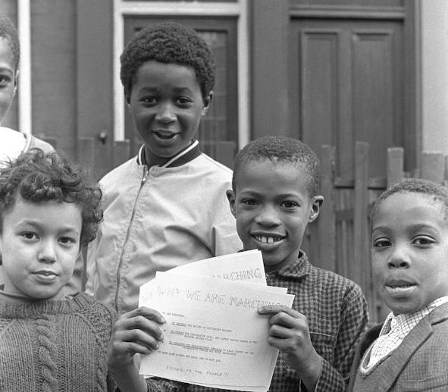
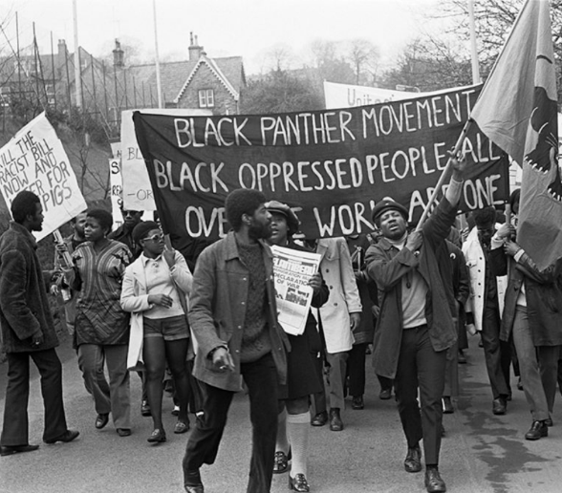
Infographic slide - style 1
Why were the Black Panthers needed?
Is anti-racist work still needed?
Notes:
Ask students why they think the Black Panthers needed to exist
Ensure that you have discussed:
In the past, racism was widespread and this included racism from public bodies such as the Police and government.
Racism impacted the quality of education that People of Colour received and how they were treated at schools – hence the need for education programmes
Children did not learn about Black history at school
Racism impacted the jobs people were able to get and how much money they earned – hence the need for things like free breakfast for children
The healthcare systems, especially in the United States, did not meet specific needs of Black people – and in the United States people often couldn’t afford to pay for treatment.
Ask students if anti racist work is still needed.
Ensure that they understand that it is!
People of Colour still face racism in their day to day lives – from people on the street, in work and education.
People of Colour still face healthcare inequalities, education inequalities and housing inequalities.
(For teacher background knowledge, see: https://library.oapen.org/handle/20.500.12657/22310)

Slide 11
Quote and image slide 1
Be more Ted
Ted Brown remains committed to addressing racism, homophobia, biphobia and transphobia, as well as other injustices.
What will you do to challenge discrimination?
Notes:
Ted Brown remains committed to addressing all forms of injustice and discrimination, but particularly racism, homophobia, biphobia and transphobia.
Ask students to reflect on what they will do in their daily life to challenge discrimination.

